Slide 1
Risk Alive Case Study

Slide 2
Objective
1. Creating a Python web app that provides a text classifier service using ML and NLP (sample training and testing sets)
2. Update the model with the entire Dbpedia14 dataset, Deploy the model, and update your web service so it uses the most recent version of the model

Slide 3
Loading the sample sets
1. Downloading and loading as pandas DataFrames
2. Checking the Shape of sample sets ((1000*3), (70,000*3))
3. Duplicate rows
4. Name and type of columns
5. Missing values
6. Almost a balanced training set

Slide 4
Features and Target value
1. Label (Target Value)
2. Title
3. Content (Features)

Slide 5
Feature Extraction
1. Bag of words (CountVectorizer)
2. TF-IDF (TfidfTransformer) is a statistical measure that evaluates how relevant a word is to a document in a collection of documents.
TF = Term frequency
IDF = Inverse Document Frequency

Slide 6
Pipelines
MultinomialNB_pipeline = Pipeline([('count_vectorizer', CountVectorizer()),
('tfidf_transformer', TfidfTransformer()),
('MultinomialNB', MultinomialNB()),
])

Slide 7
Fine Tuning Model's Hyperparameters
MultinomialNB_pipeline = Pipeline([('count_vectorizer', CountVectorizer()),
('tfidf_transformer', TfidfTransformer()),
('MultinomialNB', MultinomialNB()),
])
parameters = {'count_vectorizer__ngram_range': [(1, 1), (1, 2)],
'count_vectorizer__min_df': [i for i in range(1, 6)],
'tfidf_transformer__use_idf': [True, False],
'tfidf_transformer__sublinear_tf': [True, False], #Apply sublinear tf scaling, i.e. replace tf with 1 + log(tf).
'MultinomialNB__alpha': [0.01, 0.001]
}
grid_search = GridSearchCV(MultinomialNB_pipeline, parameters, cv=10, n_jobs=-1)

Slide 8
Models
1. Multinominal Naive Bayes
2. Nearest Neighbors Classifier
3. Decision Tree Classifier
4. Random Forest Classifier
5. Stochastic Gradient Descent (SGD) Classifier
6. Support Vector Machines (SVM)

Slide 9
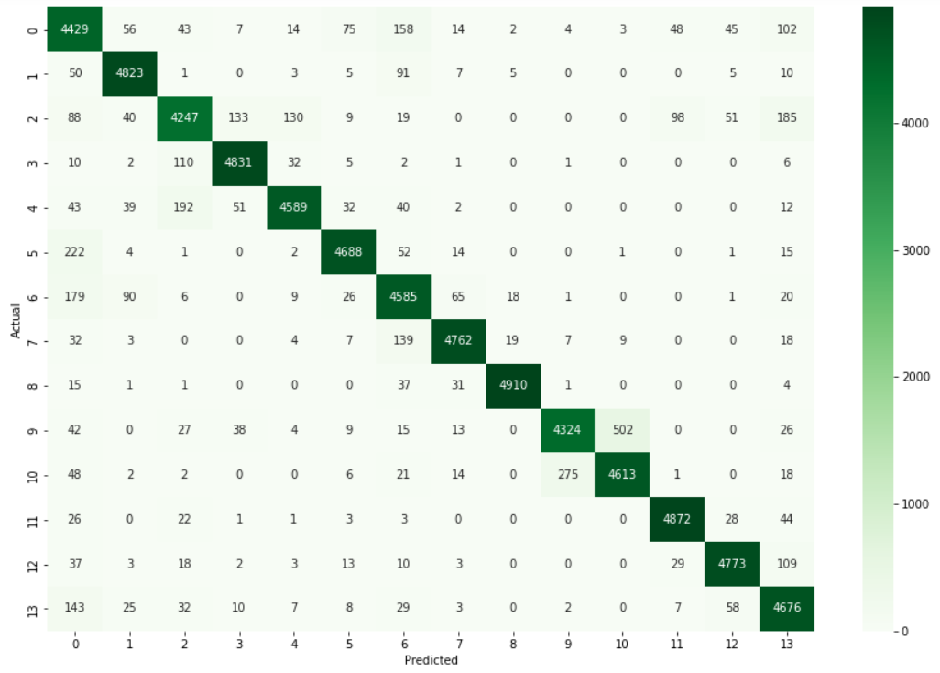
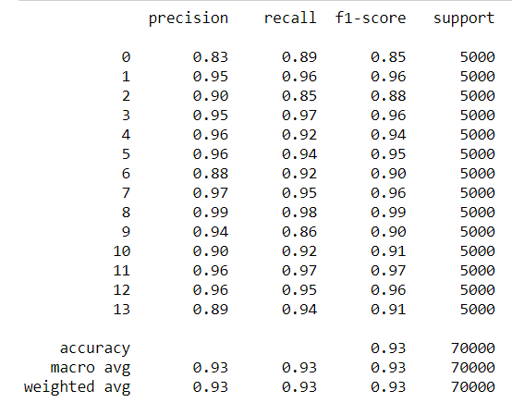
Evaluation
1. Confusion Matrix (TP, FN, FP, TN)
2. Classification Report
Precision (TP / (TP + FP))
Recall (TP / TP + FN)
F1-Score (harmonic mean of precision and Recall)

Slide 10
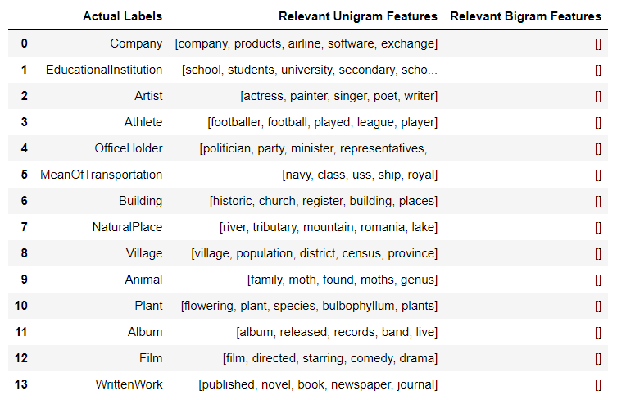
Most Relevant features
Chi2 feature selection

Slide 11
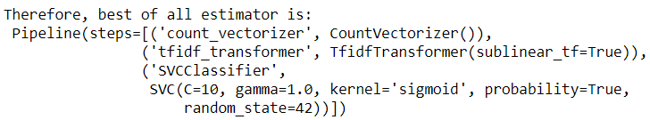
Results
Model | Accuracy
MultinomialNB | 90.8%
KNeighborsClassifier | 87.38%
DecisionTree | 74.44%
RandomForest | 87.2%
SGDClassifier | 92.03%
SVM | 93.03%
Saved the best results as best_pipeline.pkl

Slide 12
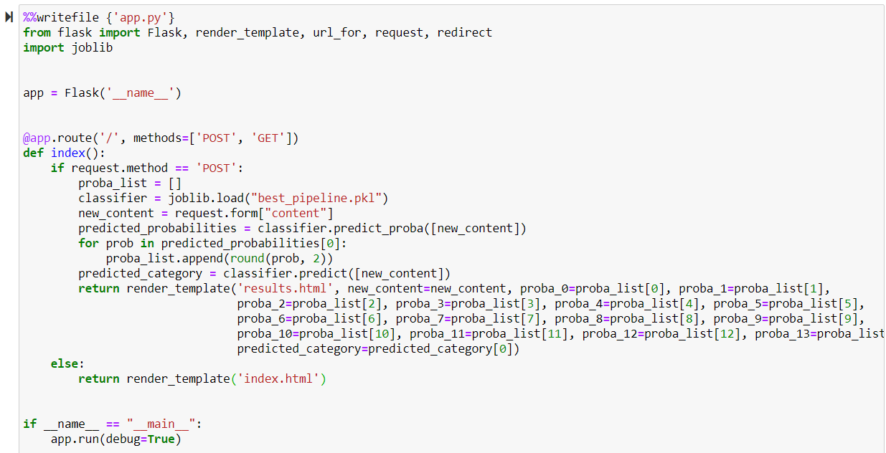
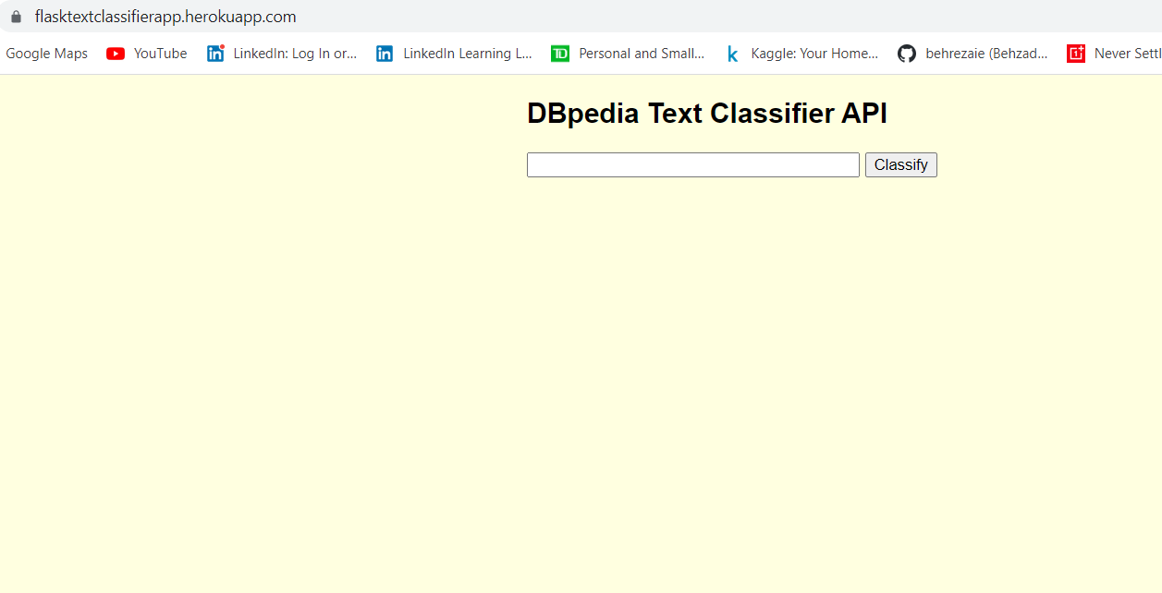
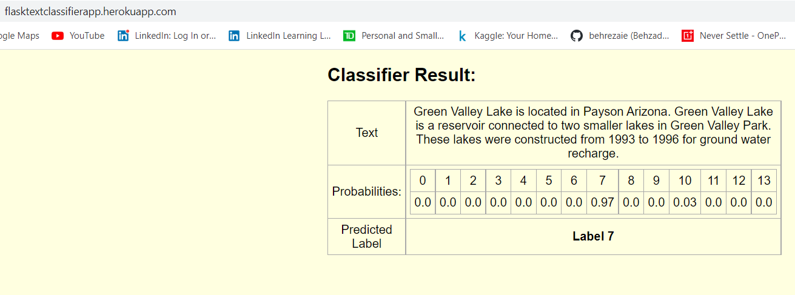
Creating a web app
Flask web framework written in Python.
Hosted both locally and on Heroku using Git commands

Slide 13
Step 2: Entire dataset
1. Downloading and loading as pandas DataFrames
2. Checking the Shape of sample sets ((560,000*3), (70,000*3))
3. Duplicate rows
4. Name and type of columns
5. Missing values
6. Balanced training set

Slide 14
Feature selection
CountVectorizer() returned 669,349 number of features
SGDClassifier_pipeline = Pipeline([('count_vectorizer', CountVectorizer()),
('Select_best_features', SelectKBest(score_func=chi2, k=15000)),
('tfidf_transformer', TfidfTransformer()),
('SGDClassifier', SGDClassifier(loss='modified_huber'))
])
No hyperparameter tunning with GridSearchCV because of time and memory limitations

Slide 15
Model Performance
Model | Accuracy
SGDClassifier | 97.8%
1. Saved the model as best_pipeline.pkl
2. Pushed the new version of the app to Heroku using Git commands
Flask Text Classifier APP

